Slide 1
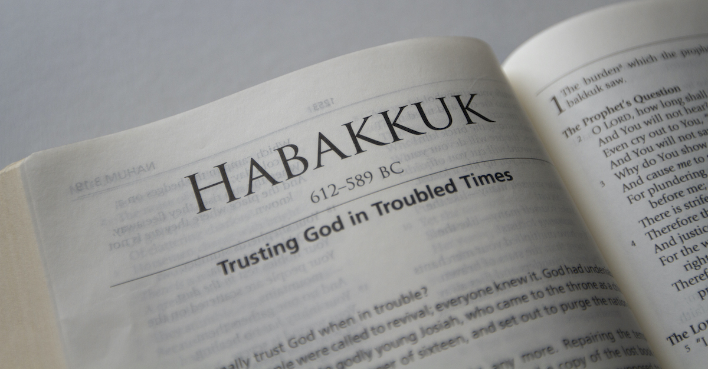

Slide 2
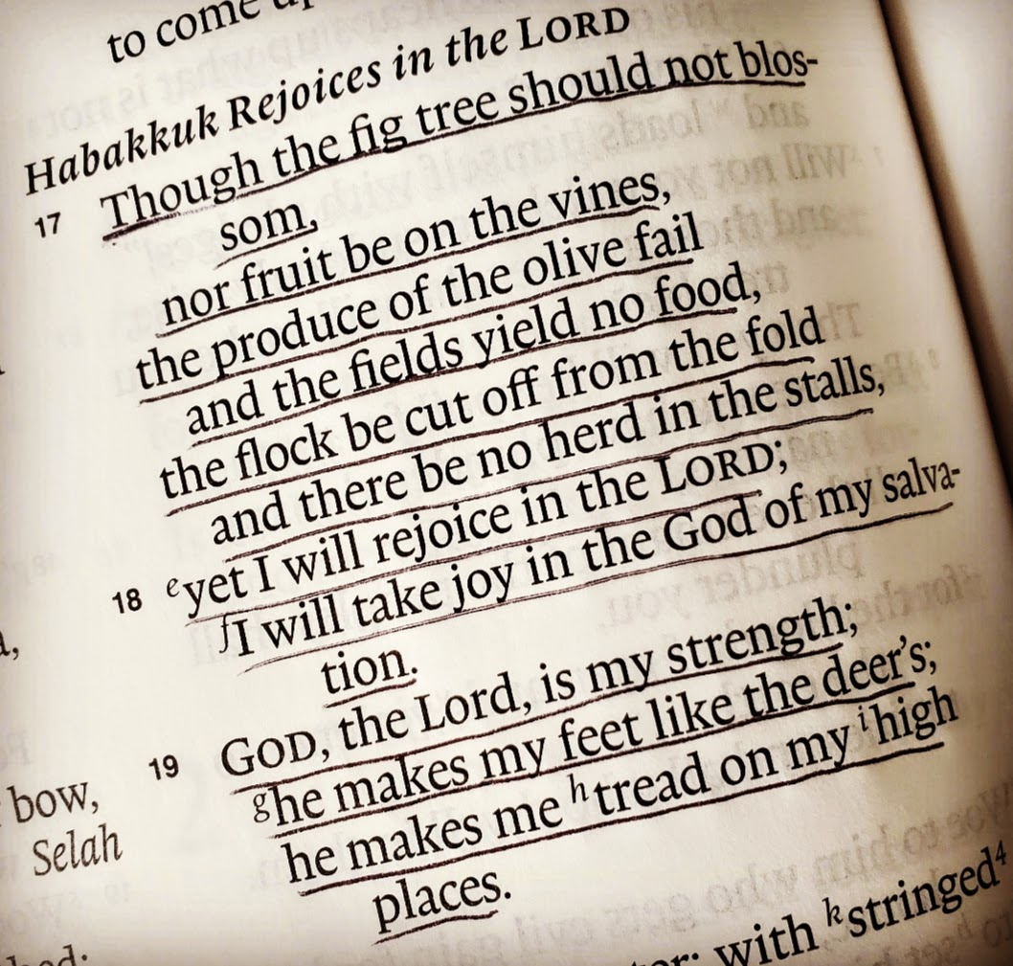

Slide 3


Slide 4



Slide 5


Slide 6
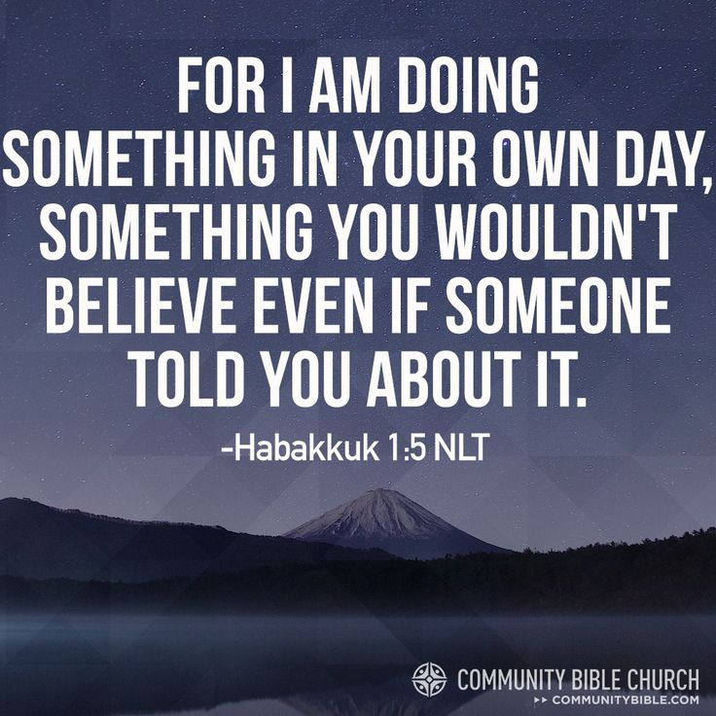

Slide 7
It’s OK to have questions
Ask God, talk to him
Listen
If you’re crying ‘How long O Lord?’ God sees you
Ask God to help you trust Him more despite any circumstances you face

